Slide 1
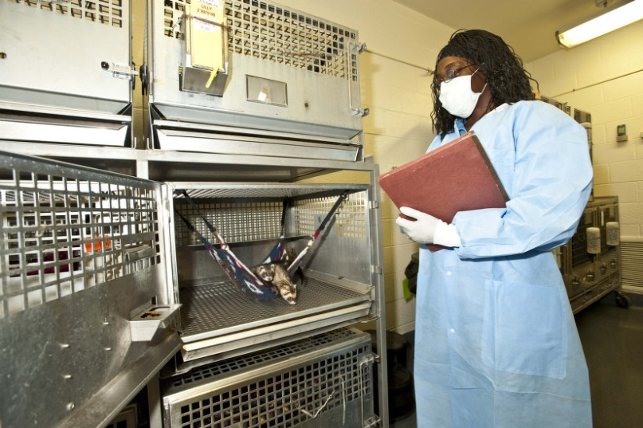
Facility Inspection Training for New IACUC Members
TTI 2018
“Peachtree City University: PCU”
Group 6: Tiffaney Duncan, Rebeccah Hunter, Krista Kilpadi, Paula Knapp, Mike Ream

Slide 2
Goal
The new IACUC member will be trained to detect minor and significant deficiencies during a semiannual facility inspection.

Slide 3
Objectives Upon completion of this module, the trainee will be able to:
Apply IACUC policies to identify deficiencies during semiannual facility inspections
Differentiate significant from minor deficiencies
Propose plans for correction

Slide 4
Why do Facility Inspections?
PHS IV. B. Functions of the IACUC
2. Inspect at least once every six months all of the institution’s animal facilities (including satellite facilities) using the Guide as a basis for evaluation
USDA AWA 2.31.c. IACUC Functions
(2) Inspect, at least once every six months, all of the research facility’s animal facilities, including animal study areas, using title 9, chapter I, subchapter A – Animal Welfare, as a basis for evaluation: provided however, that animal areas containing free living wild animals in their natural habitat need not be included in such inspection

Slide 5
PHS Policy IV.B. Functions of the IACUC:
Perform semiannual program review
Perform semiannual facility inspections
Prepare reports and submit to IO
Review research projects
Review concerns involving animal care and use
Make recommendations to IO regarding animal use
Review and approve, require modifications to secure approval, or withhold approval of animal activities
Review and approve, require modifications to secure approval, or withhold approval of proposed significant changes
Suspend animal activity
Notes:
Other Training Modules:
New member orientation
Relevant legislation, regulations, guidelines, and policies
Protocol review

Slide 6
Training IACUC Members to Perform Semiannual Facility Inspections
From the Guide: “It is the institution’s responsibility to ensure that IACUC members are provided with training opportunities to understand their work and role.”
Notes:
Other Training Modules:
New member orientation
Relevant legislation, regulations, guidelines, and policies
Protocol review

Slide 7
What is a Deficiency?
A deficiency occurs when a facility does not adhere to the institutional policies.
A deficiency is something found during either the program review or the facility inspection which is not in compliance with the PHS Policy, the provisions of the Guide for the Care and Use of Laboratory Animals or your institutional animal care and use program policies.
NOTE: Deficiencies noted will be distinguished as minor or significant with a reasonable plan and schedule for correcting each deficiency.

Slide 8
Learning Activity: Applying PCU IACUC Policies (2 minutes)
Instructions: Match the deficiency to the correct PCU IACUC policy and write the corresponding letter in the space provided.

Slide 9
PCU IACUC Policies
Expired Materials
F. Isoflurane expired on 1/30/18.
IACUC prohibits the use of analgesics, anesthetics, and euthanasia drugs beyond their expiration date.

Slide 10
PCU IACUC Policies
Gas Anesthesia Vaporizer
E. Vaporizer last professionally serviced in 2014.
The IACUC requires that vaporizers be serviced every 3 years by a qualified technician.

Slide 11
PCU IACUC Policies
Injectable Agents/Drug Storage
H. Controlled substance (e.g. ketamine) found in drawer with no lock.
Controlled substances will be stored in a locked safe, drawer, or cabinet per DEA regulations

Slide 12
PCU IACUC Policies
Euthanasia
C. Live animal found in carcass cooler.
Per AVMA Guidelines, death must be ensured prior to disposal of the animal carcass

Slide 13
PCU IACUC Policies
Non-Pharmaceutical Grade Drugs
A. Unapproved non-pharmaceutical grade analgesia (e.g. meloxicam) was seen being administered to an animal.
Per USDA and OLAW, the IACUC requires that pharmaceutical grade substances be used in all cases in which they are available.
IACUC may approve the use of non-pharmaceutical grade substances under certain circumstances, such as those cases in which pharmaceutical grade alternatives are not available

Slide 14
PCU IACUC Policies
Prolonged Restraint
G. Rabbit in restraint device for 6 hours; only approved for 4 hours.
The type and maximal duration of restraint should be stated within the protocol. The use of prolonged restraint needs to be scientifically justified, and has to be approved by the IACUC.
Notes:
Prolonged restraint should be avoided unless it is essential for achieving the research objectives. Restraint devices should be suitable in size, design, and operation to minimize discomfort or injury to the animal.

Slide 15
PCU IACUC Policies
Sanitation of Research Equipment
D. Feces found on animal treadmill.
It is the responsibility of the individual(s) using a procedural area or equipment in their own lab to disinfect all equipment and work surfaces that may come in contact with animals prior to and after each use.

Slide 16
PCU IACUC Policies
Animal Enrichment
B. Mouse housed alone with no enrichment; no exemption listed on cage card.
Mice must be group or pair housed unless otherwise approved by the IACUC.
Minimum enrichment for socially housed mice: nesting materials in addition to the regular bedding
Deviations from this policy must be approved by the IACUC and animal cages must be clearly labeled to document the exemption.

Slide 17
Distinguishing Significant from Minor Deficiencies
PHS Policy IV.B.2.d. and OLAW FAQ E.2.
A significant deficiency is one that is or may be a threat to the health or safety of the animals. Deficiencies must contain a reasonable and specific plan and schedule for correction.

Slide 18
Learning Activity: Differentiating Minor and Significant Deficiencies (1 minute)

Slide 19
Minor or Significant?
A. Unapproved non-pharmaceutical grade analgesia (e.g. meloxicam) was seen being administered to an animal.
B. Mouse housed alone with no enrichment; no exemption listed on cage card.
C. Live animal found in carcass cooler.
D. Feces found on rotarod.
Significant
Minor
Significant
Minor

Slide 20
Minor or Significant?
E. Vaporizer last professionally serviced in 2014.
F. Isoflurane (anesthetic) expired on 1/30/18.
G. Rabbit in restraint device for 6 hours; only approved for 4 hours.
H. Controlled substance (e.g. ketamine) found in drawer with no lock.
Minor
Minor
Significant
Minor

Slide 21
Plan for Corrections
Once a facility inspection is complete, an IACUC member may suggest corrective actions to remedy a deficiency.
Example
Deficiency: Controlled drug logs are incomplete.
Suggested corrective plan: PI should retrain their staff on logging controlled substances correctly and completely.

Slide 22
Learning Activity: Proposing Plans for Corrective Action

Slide 23
Learning Activity: (Each group would be asked to collaborate and propose a corrective plan for one of the listed deficiencies and then report out)

Slide 24
Objectives The trainee should now be able to:
Apply IACUC policies to identify deficiencies during semi-annual facility inspections
Differentiate significant from minor deficiencies
Propose plans for correction

Slide 25
Summative Assessment Mock Facility Inspection
Each learner will perform the following:
Inspect the mock laboratory and identify deficiencies
Categorize deficiencies as minor or significant
Propose corrective plan for two (2) deficiencies.

Slide 26
Summative Assessment Mock Facility Inspection
Grading
Learner must identify 70% of the presented deficiencies and correctly differentiate them as minor or significant.
The two proposed corrective plans must be reasonable and specific to the deficiency.

