Slide 1
Post Approval Monitoring
Group 3: Rosa Harmon, Jonathan Miller,
Amy Salem, & Kate Ziegerer

Slide 2
Over-arching Goal: Learners will be able to effectively conduct Post Approval Monitoring (PAM).
Over-Arching Goal
Session
Goal & Objectives
Take Home Objectives

Slide 3
Session Goal: understand what constitutes PAM and appreciate its value to a research program
Audience: Personnel conducting PAM
Session Objectives:
Define PAM
Identify monitoring strategies
Describe PAM best practices
Justify the value of PAM
Notes:
(better AW, educational focus – not punitive)
(p34 of the Guide)

Slide 4
Take Home Objectives
Prioritize selection of approved activities for monitoring
Analyze an approved activity to select effective monitoring strategies
Analyze findings from a monitored activity
Generate a report of PAM findings to IACUC
Ensure corrective actions are implemented

Slide 5
PAM
Group Discussion: Within your group, develop a definition of Post Approval Monitoring and record it on your Flip Chart. (2 min)
Report out. (5 min)
Notes:
Objective Define PAM-

Slide 6
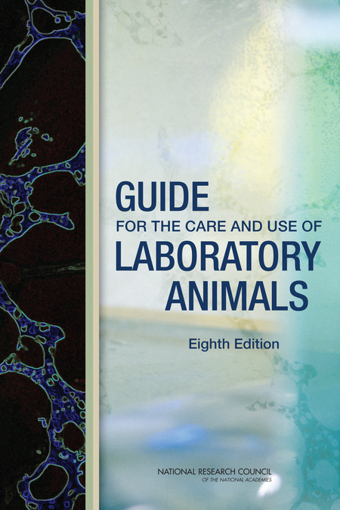
Definition of PAM
All types of protocol monitoring after the IACUC’s initial protocol approval
The Guide, p. 33

Slide 7
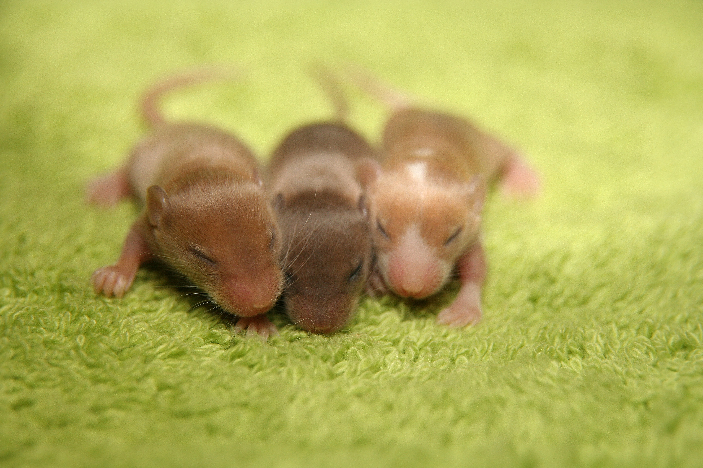
Monitoring Strategies
Ways the IACUC can monitor the conduct of the approved protocols
Example: Using breeding records to compare the number of animals produced against the number of animals on the approved protocol.

Slide 8
identifying monitoring strategies
Think individually about specific monitoring strategies that could be used to ensure a protocol is being conducted in accordance with the IACUC approval. (30 sec)
Pair up with a neighbor and discuss. (1 min)
Share with others at your table the monitoring strategies you discussed. (2 min)
Notes:
Speaker notes:
Think pair share
Ask each table to identify two strategies. After all tables report, ask if there were others identified that haven't been shared (as time allows).

Slide 9
Monitoring Strategies from the Guide, p. 34
Examination of surgical areas, including anesthetic equipment, use of appropriate aseptic technique, and handling and use of controlled substances
Review of protocol-related health and safety issues
Review of anesthetic and surgical records
Regular review of adverse or unexpected experimental outcomes affecting the animals
Observation of laboratory practices and procedures and comparison with approved protocols

Slide 10
scenario
Pamela, the post approval monitor, walks into a lab. Pamela introduces herself, and the investigator grumbles, “What is post approval monitoring?”
Pamela notices that the investigator has a cage of rodents on the bench top with a different investigator’s name on the cage card.
Pamela asks the investigator what he is planning on doing with the animals. He states he will euthanize the animals and then harvest the tissues. Pamela then asks him if he is on the protocol. He says no.
Pamela asks him not to proceed with the euthanasia until further notice. She leaves the lab, informs the IACUC of the non-compliance, and calls OLAW to report the incident.
As a table, list on your easel (1) what Pamela did well and (2) what could be improved. (3 min)
Notes:
Print-out the scenario and have each group highlight what the PAM did right and what they did wrong.
One person from each group will report to the large group.
Recommendation: good and bad – PAM introduced herself, bad she did not contact the PI who does own the animals
Left animals on the bench top.

Slide 11
justify the value of PAM
As a group, brainstorm and document on your easel the value and benefits of PAM to an animal care and use program. (2 min)
Report out. (5 min)
Circulate and use your marker to vote for two benefits you find most valuable by placing a check mark. (1 min)
Notes:
Instruct them to read their easel

Slide 12
Session Goal: Understand what constitutes PAM and appreciate its value to a research program
Session Objectives:
Define PAM
Identify monitoring strategies
Describe PAM best practices
Justify the value of PAM

Slide 13
Summative Assessments
Define PAM
1. What is the definition of Post Approval Monitoring (PAM)?
  Monitoring the effectiveness of animal husbandry activities in the animal facilities
  Monitoring protocol activities conducted after IACUC approval
  Monitoring corrective actions of facility related semi-annual inspection deficiencies
  Monitoring the completion and accuracy of controlled substance logs
Notes:
PAM is all types of protocol monitoring after the IACUC’s initial protocol approval.

Slide 14
summative assessment
Monitoring strategies
  2. Are the following monitoring strategies described in the Guide? Yes (Y) or No (N)
  ___ Reviewing experimental surgical records
  ___ Observing an experimental procedure
  ___ Evaluating the cleanliness of animal rooms
  ___ Monitoring the cage wash effectiveness with indicator strips
  ___ Reviewing unexpected outcomes and adverse events
Notes:
Project strategies from the Guide while explaining them to the group.

Slide 15
summative assessment
Best Practices
3. Identify whether or not each of the following is a best practice of PAM. Yes (Y) or No ( N)
  ____Contacting an investigator to schedule a PAM visit
  ____Concluding a PAM visit without an exit briefing
  ____Providing PAM results to the IACUC
  ____Reporting all PAM results to OLAW

Slide 16
summative assessment justifying the value of PAM
4. When justifying the value of PAM, indicate whether each of the following is True (T) or False (F).
____ PAM can improve animal welfare
____ PAM serves as an educational tool for Investigators
____ PAM increases the occurrence of non-compliance
____ PAM helps to refine research methods
____ PAM does not help to achieve AAALAC accreditation

